Slide 1
Burden of Disease Study (1990 – 2019)
By: John Markin Date: 13th April 2022 FA 550 - Spring 2022

Slide 2
Introduction:
Mortality does not give a complete picture of the burden of disease borne by individuals in different populations. The overall burden of disease is assessed using the disability-adjusted life year (DALY), a time-based measure that combines years of life lost due to premature mortality (YLLs) and years of life lost due to time lived in states of less than full health, or years of healthy life lost due to disability (YLDs). This study breaks DALY into its various components to study its trend across time and country.

Slide 3
Research Questions:
Has the burden of disease per country increased or decreased with time?
What disease are the major contributing factors of Burden of Disease from 1990 -2019?
Breakdown the top 5 burden of disease by age, non - communicable diseases, communicable, neonatal, maternal and nutritional diseases. Are there any noticeable trends?
Report the burden from injuries, violence, self-harm and accidents across

Slide 4
Visualization Tools:
Tableau – Tableau provides a host of map graphs and ease in creating dashboards. Also due to its graphical interface it makes it easy to implement graph designs without the use of extensive coding.
R Software – This project will use the gganimate of the ggplot2 package to visualize the time series analysis of the data. R provides a platform to easily shape data in the required format. The html formatting in R can easily merge visualizations from Tableau to create a scrolling story board.

Slide 5
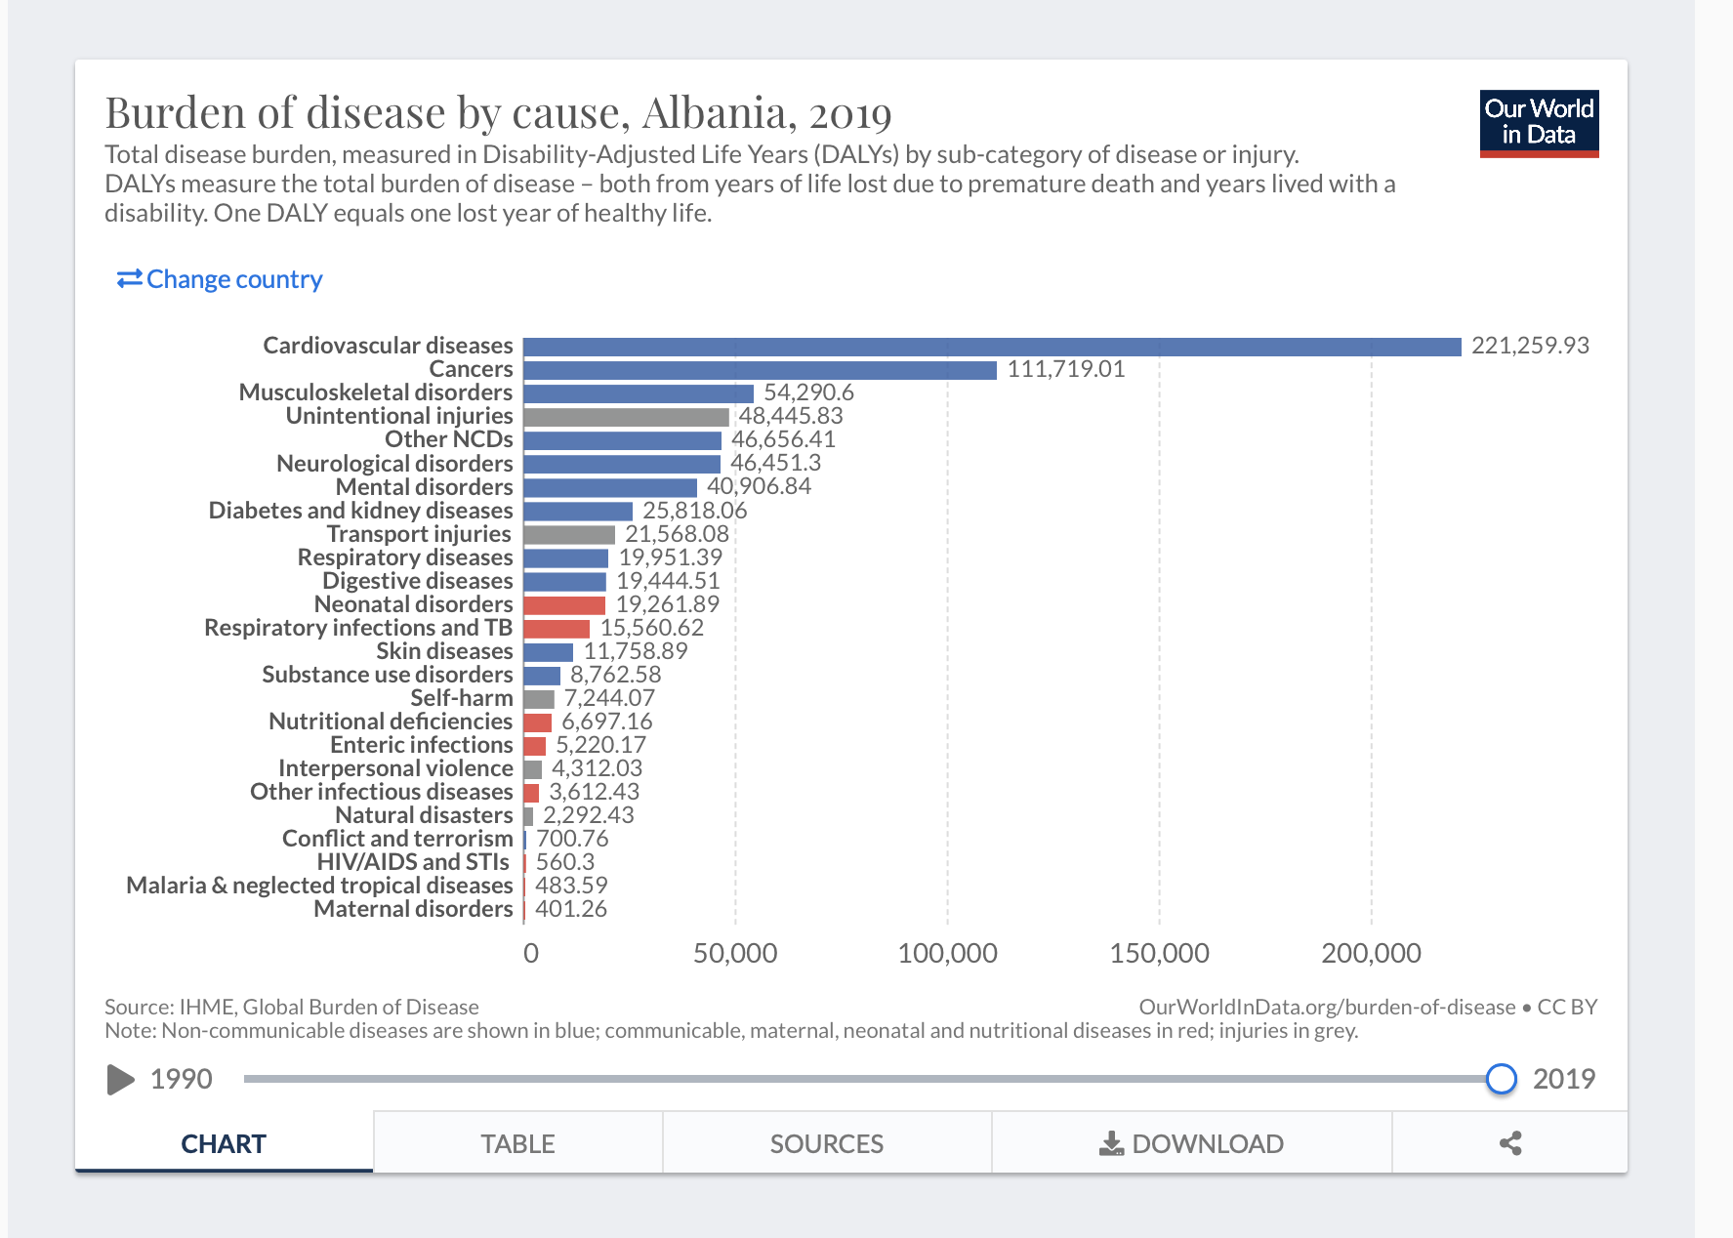
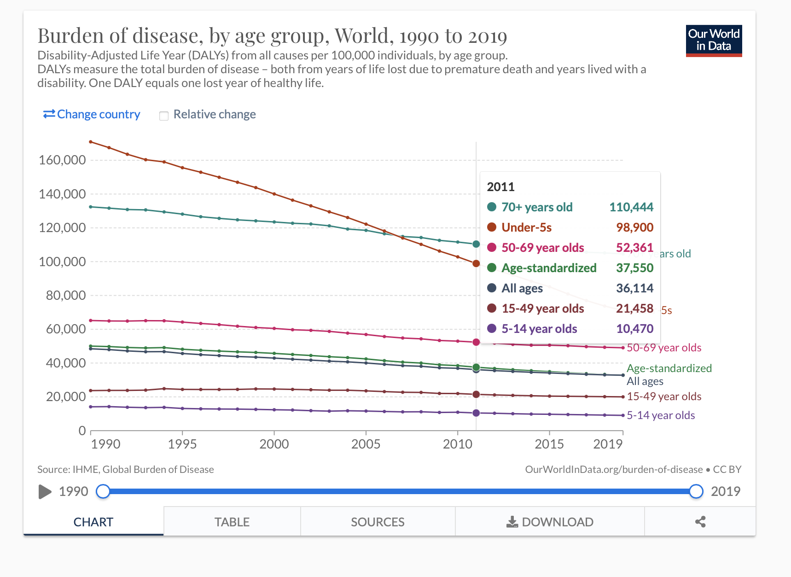
Examples of Visualization Choices Bar Chart: Animated Point -Line Graph:

Slide 6
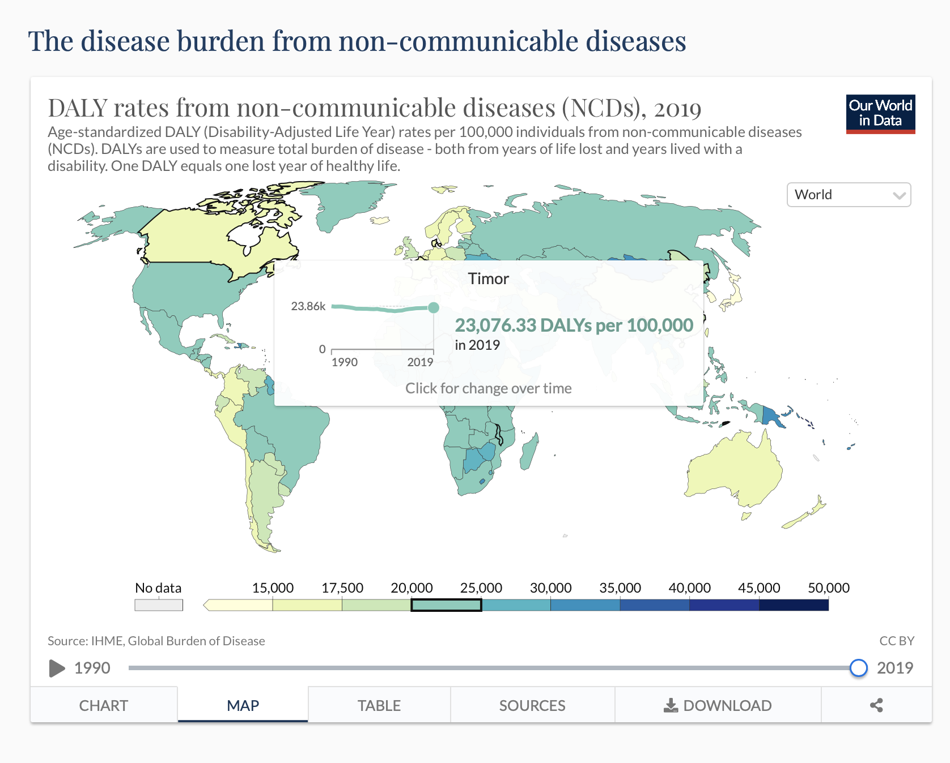
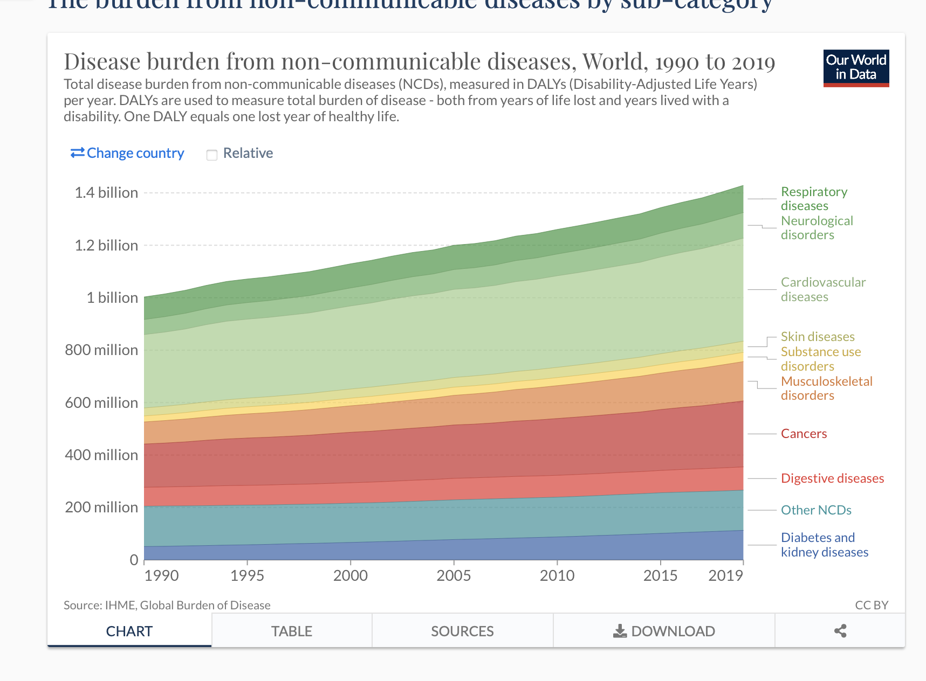
Examples of Visualization Choices Geographical Heat Maps: Stacked Line Graph:

Slide 7
Project Schedule:
Time | Activity
16/04/2022 | Gathering, Cleaning and Shaping Data Completed
27/04/2022 | Creation of All Visualizations and Including various details to the visualizations
02/05/2022 | Compile all graphs in an initial presentation draft for review
08/05/2022 | Make all changes identified from draft review.

Slide 8
Data Links:
The Data is accessed on Ourworldindata.org
https://ourworldindata.org/grapher/dalys-rate-from-all-causes?tab=table
https://ourworldindata.org/grapher/burden-of-disease-by-cause?tab=table
https://ourworldindata.org/grapher/daly-rates-from-all-causes-by-age?tab=table&country=~OWID_WRL
https://ourworldindata.org/grapher/burden-of-disease-rates-from-communicable-neonatal-maternal-nutritional-diseases?tab=table
https://ourworldindata.org/grapher/burden-of-disease-rates-from-ncds?tab=table
https://ourworldindata.org/grapher/burden-of-disease-rates-from-injuries?tab=table

Slide 9
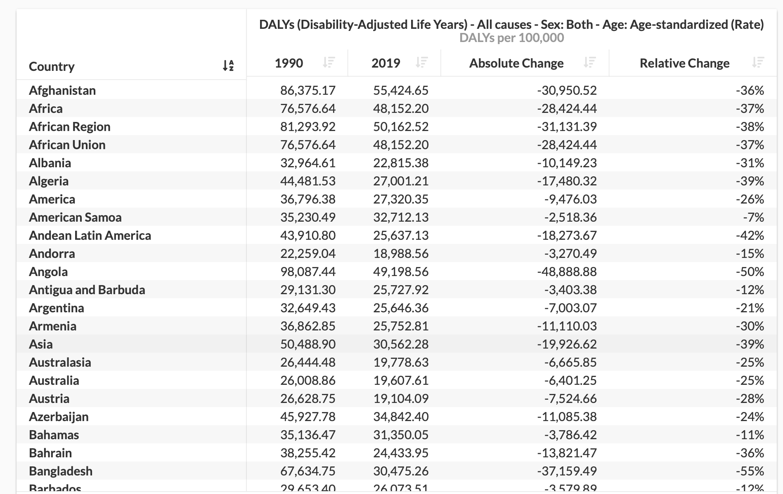
Brief Extract of Data:

Slide 10
Reference:
The project is modeled after the article below, Max Roser and Hannah Ritchie (2021) - "Burden of Disease". Published online at OurWorldInData.org. Retrieved from: https://ourworldindata.org/burden-of-disease [Online Resource].

Slide 11
THANK
YOU

